Slide 1
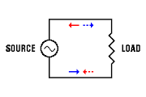
SINGLE PHASE AC CIRCUITS ANALYSIS

Slide 2
CONTENTS
1. AC CIRCUIT
PURELY RESISTIVE CICUIT
PURELY INDUCTIVE CIRCUIT
PURELY CAPACITIVE CIRCUIT
AC SERIES CIRCUITS
SERIES R-L CIRCUIT
SERIES R-C CIRCUIT
SERIES R-L-C CIRCUIT

Slide 3
CONTENTS
•
•
•
•
2. RESONANCE
RESONANCE IN SERIES
RESONANCE IN PARALLEL
RESONANCE FREQUENCY
VARIATION OF DIFF. QUANTITIES WITH
FREQUENCY
INDUCTIVE REACTANCE
CAPACITIVE REACTANCE
CURRENT

Slide 4
Introduction
AC CIRCUIT:
Circuits in which currents and voltages vary sinusoidally i,e vary with time are called alternating current or a.c circuits. All a.c circuits are made up of combination of resistance R , inductance L and capacitance C. The circuit elements R,L and C are called circuit parameters . To study a general a.c circuit it is necessary to consider the effect of each seperately.

Slide 5
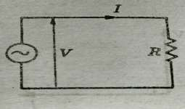
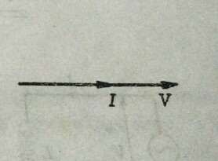
1.1 Purely Resistive Circuits
Figure shows a circuit containing only resistance R
v = V_{m} sin ωt
By Ohm’s law, the instantaneous current in the circuit will be
i =v/R =V_{m} sinωt / R
V_{m}^/ R = I_{m}
i=I_{m} sinωt
Comparison of voltage equation and current shows that the phase difference are in phase difference between voltage and current is zero . Hence , in a circuit with resistance only the voltage and current are in phase with each other .

Slide 6
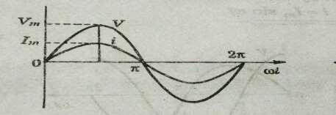
The waveform and phase diagram respectively of the voltage and current in a circuit containing only a resistance .
Since maximum value = √2 * r.m.s. Value
I_{m} = √2 I: V_{m} = √2 V
√2 V/R = √2 I V = RI
Above eq=n represents ohm’s law
It is noted that applied voltage is counter balanced by the voltage drop across the resistance R . This voltage drop is called resistive voltage drop and denoted by V_{r} .
V_{r} = V V_{r} = IR

Slide 7
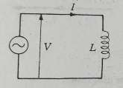
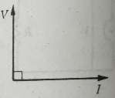
1.2 Purely Inductive Circuit
Consider a purely inductive circuit containing only an inductance L
. Let the current taken by the circuit be
I = I_{m}sinωt
This current produces a self induced e.m.f. e_{L} in the circuit given by
e_{L}= -L di/dt
At any instant two voltages are present in the circuit , one is the applied voltage e_{L} . By KVL
v = - e_{L} = L di/dt = L d(I_{m}sin ωt)/dt
= ωLI_{m}cosωt = ωLI_{m}sin(ωt+ 90⁰)
If ωLI_{m} = V_{m}
v = V_{m} sin(ωt+ 90⁰)
Comparison shows that the phase difference between voltage and current is 90 .

Slide 8
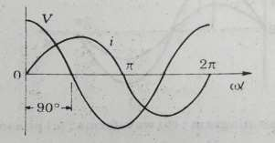
If Φ is measured from the current phase Φ =
+90⁰ .
Hence , in a purely inductive circuit the voltage leads the current by 90⁰ or the current lags by 90⁰.
The waveform and phasor diagram respectively of the voltage and current containing only on inductance .

Slide 9
Inductive Reactance
ωL( I I) = V
ωL = V/I
The quantity ωL is the ratio of the r.m.s. voltage to r.m.s. current in purely inductive circuit . It is called the inductive reactance of the circuit and is denoted by the symbol X_{L} . Since it is the ratio of voltage and current it is measured in ohms .
The opposition of inductance to the flow of alternating current is defined as the inductive reatance X_{L} .

Slide 10
X_{L} = ωL
= 2 πfL V = X_{L} I
Also ,
The voltage drop across the inductance L is called the inductive voltage drop . It is denoted by V_{L} .
V_{L} = V V_{L} = X_{L} I

Slide 11
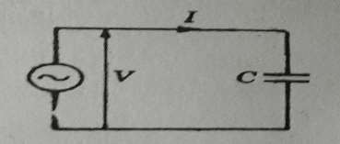
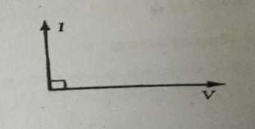
1.3 Purely Capacitive circuit
Consider a purely capacitive circuit containing only a capacitor C connected to an a.c. Supply voltage given by
v= V_{m}sin ωt
The current in the circuit at any instant is
i =dq/dt
•
i =d (Cv)/dt = C dv/dt = C d(V_{m}
= ωCV_{m} cos ωt = ωCV_{m}
sinωt)/dt
sin(ωt+90⁰)
•
•
•
ωCV ^ = I
m m
i = I_{m} sin(ωt+90⁰⁾

Slide 12
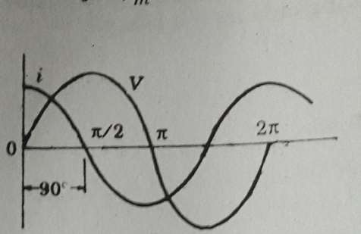
Comparison shows that the phase difference Φ between the voltage and the current is 90^{0.} if Φ is measured from the voltage phasor Φ =
+90⁰.Hence in purely capacitive circuit current
leads the voltage by 90⁰.The waveforms and phasor diagram respectively for a circuit containing capacitance alone.

Slide 13
Capacitive Reactance
•
•
ωC( √2V)= √2I
V/I=1/ωC
The ratio of r.m.s. Voltage to r.m.s. Current in a purely capacitive circuit is called the capacitive reactance. It is defined as the opposition offered by a purely capacitive circuit to the flow of sinusoidal current. The capacitive reactance is denoted by X_{c} and
is measured in ohms.
Xc= 1/ωC= 1/2πfC
V/I= X
V= X_{c}I
The part of the supply which charges the capacitor is known as the capacititve voltage drop.
V_{c}= V
V_{c}= X_{c}I
•
•

Slide 14
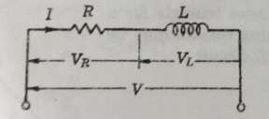
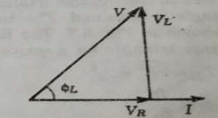
1.4 Series R-L Circuit
Consider a circuit containing a resistance R and an inductance L in series
Let V = supply voltage
I = circuit current
V_{R} = voltage drop across R = RI
V_{L} = voltage drop across L = X_{L}I= 2πfLI
Φ_{L} = phase angle between I and V
Since I is common to both elements R and L,this is used as reference phasor. The voltage V_{R} is in phase with I and V_{L} leads by 90⁰ . The voltage V is the phasor sum of V_{R} and V_{L} that is the phasor diagram:

Slide 15
The triangle having V_{R},V_{L} and V as its sides is called voltage triangle for a series R-L circuit:
The phase angle Φ_{L} between the supply voltage V and the circuit current I is the angle between the hypotenuse and the side V_{R} .It is seen that
the current I is lagging behind the voltage V in an R-L circuit.
V² = V²_{R} + V²_{L}
= (RI)² + (X_{L} I)² V²/I² = R² + X²_{L}
V/I = √(R² + X²_{L})
•
•
•
•
•
Z_{L} = √(R² + X²_{L})
Z_{L} is called the impedance of a series R-l circuit Z_{L} = V/I
V = Z_{L} I
•
•

Slide 16
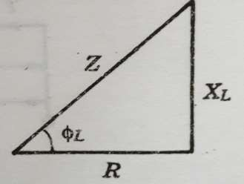
Impedance Triangle for a Series R- L Circuit
If the length of each side of the voltage triangle is divided by current I , the impedance triangle is obtained . The impedance triangle for a series R-L circuit is given. The following results may be found from an impedance triangle for a series R-L circuit:
•
•
•
•
Z_{L} = √(R² + X²_{L})
R = Z_{L}cosΦ_{L} X_{L} = Z_{L} sinΦ_{L}
tanΦ_{L} = X_{L} /R

Slide 17
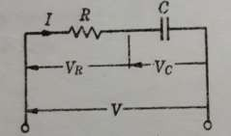
1.5 Series R-C
Circuit
A circuit containing a resistance R and a capacitance C in series
Let V = supply voltage
I = circuit current
V_{R} = voltage drop across R = RI
V_{C} = voltage drop across C =X_{C}I = I/2πfC
Φ_{C} = phase angle between I and V
The voltage V_{R} is in phase with I and V_{C} lags I by 90⁰ .The voltage sum is:
V = V_{R} + V_{C}

Slide 18
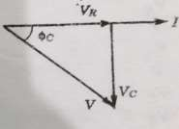
The phasor diagram:
The triangle having V_{R} , V_{c} and V as its side is called voltage triangle for
a series R-C circuit.
The phase angle Φ_{C} between the supply voltage and the circuit current is the angle between the hypotenuse and the side V_{R} . It is observed :
V² = V²_{R} + V²_{c}
= (RI)² + (X_{c} I)² V²/I² = R² + X²_{c} V/I = √(R² + X²_{c})
Z_{c} = √(R² + X²_{c})
Z_{c} is called the impedance of a series R-C circuit
Z_{c} = V/I
V = Z_{c} I

Slide 19
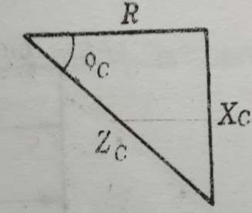
Impedance Triangle for a Series R-
C Circuit
If the length of each side of the voltage triangle is divided by current I , the impedance triangle is obtained . The impedance triangle for a series R-C circuit is given. The following results may be found from an impedance triangle for a series R-C circuit:
Z_{C} = √(R² + X² )
C
R = Z_{C}cosΦ_{C}
X_{C} = Z_{C} sinΦ_{C} tanΦ_{C} = X_{C} /R

Slide 20
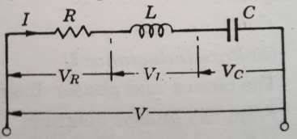
1.6 Series RLC circuit
A circuit having R, l and C in series is called a general series circuit current is used as reference phasor in series circuit since it is common to all the elements of circuit. There are four voltages
V_{R} in phase with I V_{L} leading I by 90⁰ V_{C} lagging I by 90⁰
Total voltage V = V_{R} + V_{L} + V_{C}

Slide 21
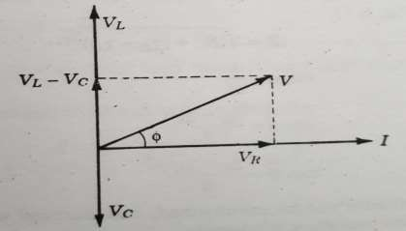
Phasor diagram:
V_{L} and V_{C} are in opp. Directions and their resultant is their arithmetic differnce
There are 3 possible cases in series RLC circuit
a. V_{L} | > V_{C} | i.e; X_{l} | > X_{C}
b. V_{L} | < V_{C} | i.e; X_{l} | < X_{C}
c. V_{L} | = V_{C} | i.e; X_{l} | = X_{C}

Slide 22
When X_{L} > X_{C} the circuit is predominantly inductive .
# Inductive circuits cause the current ‘lag’ the voltage.
•
•
V=I √[R² + ( X_{l} - X_{C} )²] Z = √[R² + ( X_{l} - X_{C} )²]
When X_{L} < X_{C} the circuit is predominately capacitive.
# Capacitive circuits cause the current to ‘lead’ the voltage.
•
•
V=I √[R² + ( X_{c} - X_{l} )²] Z = √[R² + ( X_{c} - X_{L} )²]

Slide 23
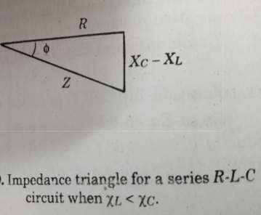
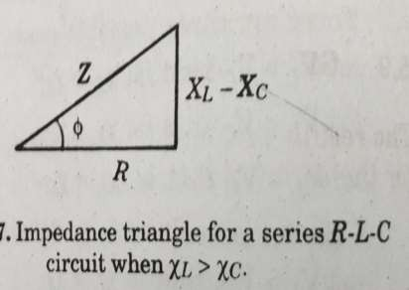
Impedance Triangle for RLC circuit
If the length of each side of a voltage triangle is divided by current I, the impedance triangle is obtained. The impedence triangle for series RLC circuit :

Slide 24
2. RESONANCE
Resonance is a condition in an RLC circuit in which the capacitive and inductive reactance are equal in magnitude, thereby resulting in a purely resistive impedance.
At resonance, the impedance consists only resistive component R.
The value of current will be maximum since the total impedance is minimum.
The voltage and current are in phase.
Maximum power occurs at resonance since the power factor is unity
Resonance circuits are useful for constructing filters and used in many application.

Slide 25
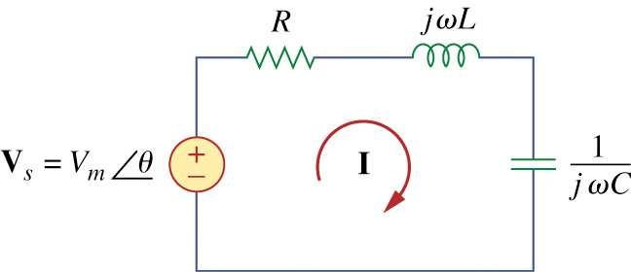
2.1 Series Resonance Circuit

Slide 26
2.2 Resonance in series RLC circuit
Total impedance of series RLC
Circuit is
Z_{Total} = R + jX _{L} - jX _{C}
Z_{Total} = R + j(X_{L} - X_{C} )
At resonance
X_{L} = X_{C}
The impedance now
The current at resonance
reduce to
V_{s} V_{m}
^{Z}Total ^{= R}
I_{m} = _{Z} = _{R}
Total

Slide 27
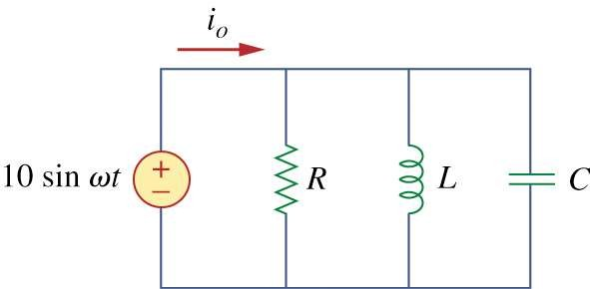
2.3 Parallel Resonance

Slide 28

At resonance, currents I_{L} and I_{C} are equal and cancelling giving a net reactive current equal to zero. Then at resonance the above equation becomes.

Slide 29
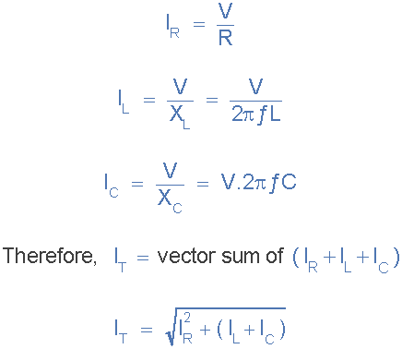
We remember that the total current flowing in a parallel RLC circuit is equal to the vector sum of the individual branch currents and for a given frequency is calculated as:

Slide 30
2.4 Resonance Frequency
Resonance frequency is the frequency where the condition of resonance occur.
Also known as center frequency. Resonance frequency
1
ω =
rad/s
o
LC
1
f_{o} = Hz
2π LC

Slide 31
VARIATION OF DIFFERENT QUANTITIES WITH FREQUENCY

Slide 32
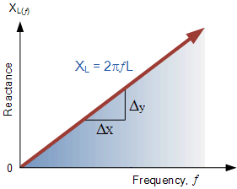
2.5 Variation of inductive
reactance with frequency
The inductive reactance X_{L} =2∏fL is directly proportional to the frequency f .Hence its graph is a straight line through the origin

Slide 33
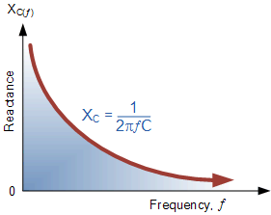
2.6 Variation of capacitive reactance with frequency
The capacitive reactance X_{C} =1/2πfC is inversely proportional to the frequency . Hence its graph is a rectangular hyperbola X_{L} versus f and X_{C} versus f curves cut at a point where f=f₀

Slide 34
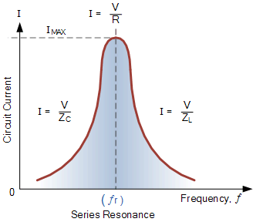
2.7 Variation of current with frequency
The current versus frequency is known as resonance curve or response curve . The current has a maximum value at resonance given by I₀ = V/R. The value of I decreases on either sides of the resonance

Slide 35
THANK YOU

